Slide 1
Chapter 17
Health Psychology
© 2020 McGraw-Hill Education. All rights reserved. Authorized only for instructor use in the classroom. No reproduction or further distribution permitted without the prior written consent of McGraw-Hill Education
Notes:
Photo credit: © Jamie Grill/JGI/Getty Images

Slide 2
But first… Announcements!
Research pool closes 11/28 @ 5:00pm
Quiz 11 due 11/29 @ Midnight
Don’t show up on Thursday! (11/24)
Exam 4 (12/1)
Final (12/6 @ 1:00pm) FINAL IS OPTIONAL

Slide 3
What is Health Psychology?
Practice of helping motivate people towards making health-conscious decisions
Interested in how the mind and body are linked
Key questions:
  What motivates people to make healthy decisions?
  Why do some people make healthy lifestyle choices when others don’t?

Slide 4
What do Health Psychologists do?
In addition to researching health motivation:
  Design and create treatment plans using psychological principles:
    Example: Using therapy methods to change eating habits, get individuals to stop smoking, etc.

Slide 5
Health Psychologist Example
Often look at link between body and mind
Is there a link between physical and mental symptoms?
Example: Individual reports headaches and stomach problems due to anxiety
  Is the anxiety causing the physical symptoms or is the other way around?

Slide 6
Research in Health Psych
Much research is applied in nature
Applied research looks for solutions to practical problems
  Example: Researching the link between nicotine and stress as part of a smoking intervention

Slide 7
Health Psych is different from:
Behavioral Medicine
  focuses on social, behavioral and biomedical factors
Health Promotion
  helps individuals improve their lifestyles
Public Health
  helps policy makers

Slide 8

Biopsychosocial Model
Health psychology integrates biological, psychological, and social factors in health.

Slide 9
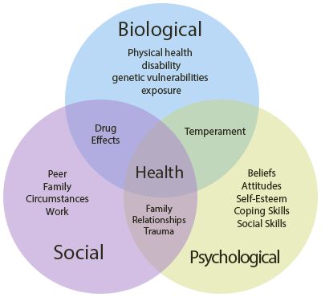

Slide 10
The Mind-body Relationship
The impact of the mind on the body
            choices & attitudes
        Example: Diabetes and Anxiety
          Diabetes requires carefully monitoring of blood sugar
          Anxiety might cause individuals to miss these cues, leading to complications
          Missing cues → more anxiety → cycle repeats

Slide 11
The Mind-body Relationship
The impact of the body on the mind
            physical stress & health
        Example: Stress and Immune System
          Stress diminishes white blood cell response, leading to prolonged illness
          Being sick longer → more stress → cycle repeats

Slide 12
The Role of Health Psychologists
        Focus on mind-body relationship!
        Helping individuals w/ mental elements will improve physical outcomes
        Often work in partnership with a physician who treats physical health issues

Slide 13
The Role of Health Psychologists
        Because health outcomes are linked to behavior, health psychologists often focus on changing how a person acts
        Rewarding individuals for engaging in healthy practices
        Operant conditioning!

Slide 14
Theoretical Models of Behavioral Change
Theory of Reasoned Action
  Effective change requires:
    specific intentions about behavior
    positive attitude about the new behavior
    perceptions of social group support
  Changing behavior requires effortful commitment!

Slide 15
Theoretical Models of Behavioral Change
Theory of Planned Behavior
  Effective change also requires:
    perceptions of control over the outcome
    High vs. Low perceived control
Criticism: Sometimes our health decisions are not rational.

Slide 16
How Do Individuals Make Healthy
Lifestyle Changes?
Stages of Change Model
  1. Precontemplation
    not ready to even think about it
  2. Contemplation
    acknowledge problem
  3. Preparation/determination
    plan action, explore options
  4. Action/willpower
    commit to and enact plan
  5. Maintenance
    long term success avoiding relapse; Achieve Transcendence

Slide 17
How Do Individuals Make Healthy
Lifestyle Changes?
Transcendence: Individual no longer consciously tries to maintain healthy lifestyle
Healthy behavior is now a habit!
Examples: An individual is now a committed runner; a smoke is now a non-smoker, etc.

Slide 18
How Do Individuals Make Healthy
Lifestyle Changes?
Relapse: Return to previous unhealthy patterns
Relapse is common: Most people who attempt to change usually fail at first
One slip-up is not usually a problem, becomes a problem when failure becomes the norm

Slide 19
Personal Motivation
What motivates people to act in certain ways?
What leads people to make healthy vs. unhealthy decision?

Slide 20
Personal Motivation
Self-Determination Theory:
  How do people make choices and manage their own lives?
  Self-determination is related to degree of control
    High-control individuals == feel in control of their own life, feel like they can make changes when needed
    Low-control individuals == feel like their life is controlled by other people, “just along for the ride”

Slide 21
Personal Motivation
Intrinsic vs. Extrinsic Motivation
People who are intrinsically motivated:
  Engage in activates for the inherent reward
People who are extrinsically motivated:
  Motivated by outside factors

Slide 22
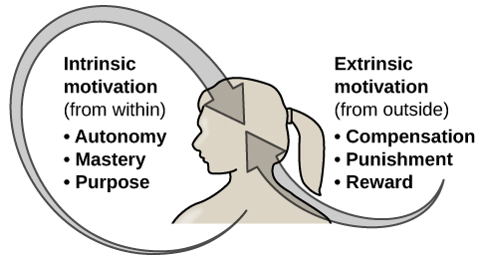
Personal Motivation

Slide 23
Which one is better?
Extrinsic motivation:
  Good for short-term goals or changes
Intrinsic motivation:
  Better for long-term, lasting change

Slide 24
Self-Efficacy and Health
Self-Efficacy:
  Belief that one can master a situation or achieve something
  Higher levels == greater health outcomes
    More likely to stick to plans
    Less likely to be discouraged by setbacks
    More likely to find solutions to problems

